Slide 1
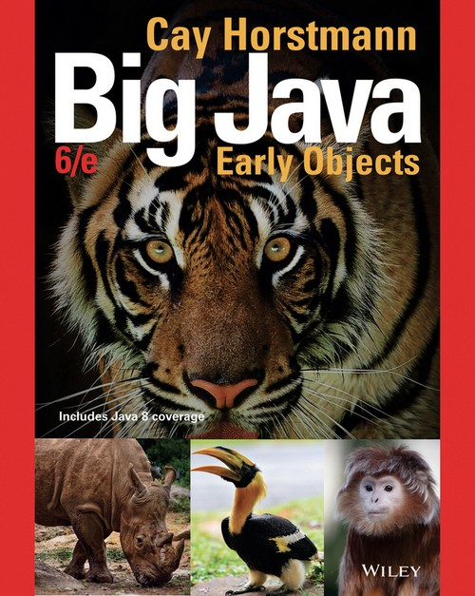
Chapter 5 – Decisions

Slide 2

Chapter Goals
To implement decisions using if statements
To compare integers, floating-point numbers, and strings To write statements using the Boolean data type
To develop strategies for testing your programs To validate user input

Slide 3
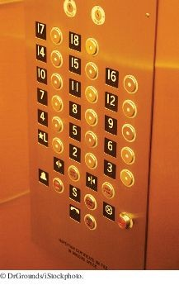
The if Statement
The if statement allows a program to carry out different actions depending on the nature of the data to be processed.
This elevator panel “skips” the thirteenth floor. The floor is not actually missing—the computer that controls the elevator adjusts the floor numbers above 13.
int actualFloor; if (floor > 13)
{
actualFloor = floor - 1;
}
else
{
actualFloor = floor;
}

Slide 4
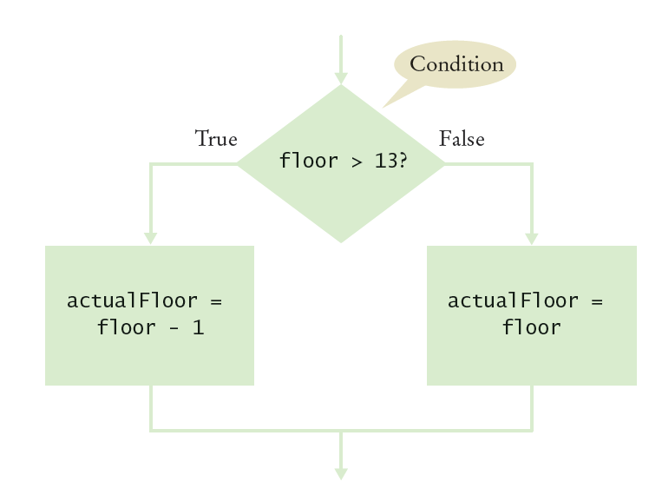
The if Statement
Flowchart with two branch
You can include as many statements in each branch as you like.

Slide 5
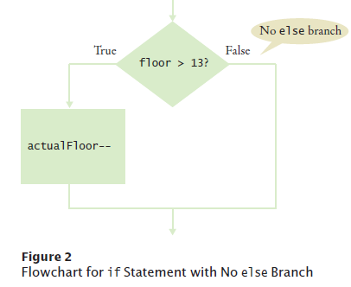
The if Statement
Flowchart with one branches
When there is nothing to do in the else branch, omit it entirely
int actualFloor = floor; if (floor > 13)
{
actualFloor--;
} // No else needed

Slide 6
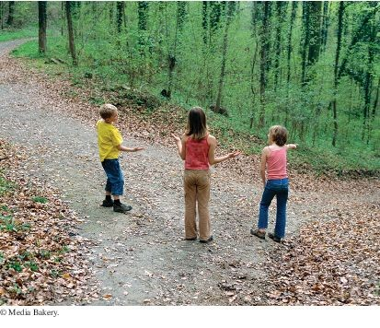
The if Statement
An if statement is like a fork in the road. Depending upon a decision, different parts of the program are executed.

Slide 7
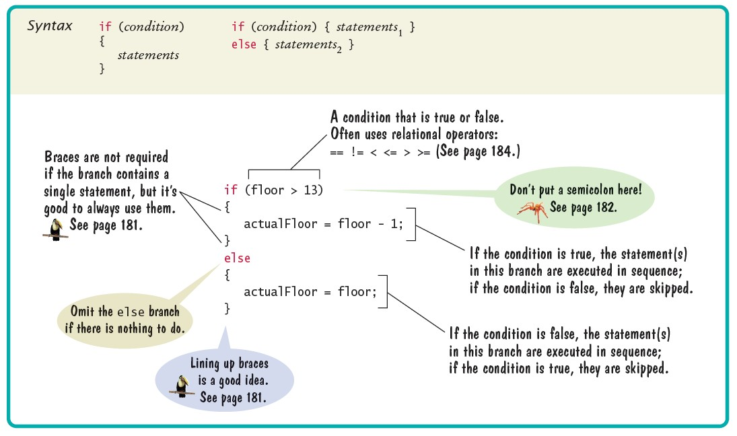
Syntax 5.1 The if Statement

Slide 8
section_1/ElevatorSimulation.java
1 import java.util.Scanner;
2
3 /**
4 This program simulates an elevator panel that skips the 13th floor.
5 */
6 public class ElevatorSimulation
7 {
8 public static void main(String[] args)
9 {
Scanner in = new Scanner(System.in);
System.out.print("Floor: ");
int floor = in.nextInt();
13
14
15
16
17
18
19
20
21
22
23
24
25
26
27
28
29 }
// Adjust floor if necessary
int actualFloor; if (floor > 13)
{
actualFloor = floor - 1;
}
else
{
actualFloor = floor;
}
System.out.println("The elevator will travel to the actual floor "
+ actualFloor);
}
Program Run:
Floor: 20
The elevator will travel to the actual floor 19

Slide 9
Self Check 5.1
In some Asian countries, the number 14 is considered unlucky. Some building owners play it safe and skip both the thirteenth and the fourteenth floor. How would you modify the sample program to handle such a building?
Answer: Change the if statement to
if (floor > 14)
{
actualFloor = floor - 2;
}

Slide 10
Self Check 5.2
Consider the following if statement to compute a discounted price:
if (originalPrice > 100)
{
discountedPrice = originalPrice - 20;
}
else
{
discountedPrice = originalPrice - 10;
}
What is the discounted price if the original price is 95? 100? 105?
Answer: 85. 90. 85.

Slide 11
Self Check 5.3
Compare this if statement with the one in Self Check 2:
if (originalPrice < 100)
{
discountedPrice = originalPrice - 10;
}
else
{
discountedPrice = originalPrice - 20;
}
Do the two statements always compute the same value? If not, when do the values differ?
Answer: The only difference is if originalPrice is 100. The statement in Self Check 2 sets discountedPrice to 90; this one sets it to 80.

Slide 12
Self Check 5.4
Consider the following statements to compute a discounted price:
discountedPrice = originalPrice; if (originalPrice > 100)
{
discountedPrice = originalPrice - 10;
}
What is the discounted price if the original price is 95? 100? 105?
Answer: 95. 100. 95.

Slide 13
Self Check 5.5
The variables fuelAmount and fuelCapacity hold the actual amount of fuel and the size of the fuel tank of a vehicle. If less than 10 percent is remaining in the tank, a status light should show a red color; otherwise it shows a green color. Simulate this process by printing out either "red" or "green".
Answer:
if (fuelAmount < 0.10 * fuelCapacity)
{
System.out.println("red");
}
else
{
System.out.println("green");
}

Slide 14
Avoid Duplication in Branches
If you have duplicate code in each branch, move it out of the if
statement.
Don't do this
if (floor > 13)
{
actualFloor = floor - 1;
System.out.println("Actual floor: " + actualFloor);
}
else
{
actualFloor = floor;
System.out.println("Actual floor: " + actualFloor);
}

Slide 15
Avoid Duplication in Branches (continued)
Do this instead
if (floor > 13)
{
actualFloor = floor - 1;
}
else
{
actualFloor = floor;
}
System.out.println("Actual floor: " + actualFloor);
It will make the code much easier to maintain. Changes will only need to be made in one place.

Slide 16

Comparing Values: Relational Operators
In Java, you use a relational operator to check whether one value is greater than another.

Slide 17
Comparing Values: Relational Operators
Relational operators compare values:
Java > | Math Notation > | Description Greater than
>= | ≥ | Greater than or equal
< | < | Less than
<= | ≤ | Less than or equal
== | = | Equal
!= | ≠ | Not equal
The == denotes equality testing:
floor = 13; // Assign 13 to floor
if (floor == 13) // Test whether floor equals 13
Relational operators have lower precedence than arithmetic operators:
floor - 1 < 13

Slide 18
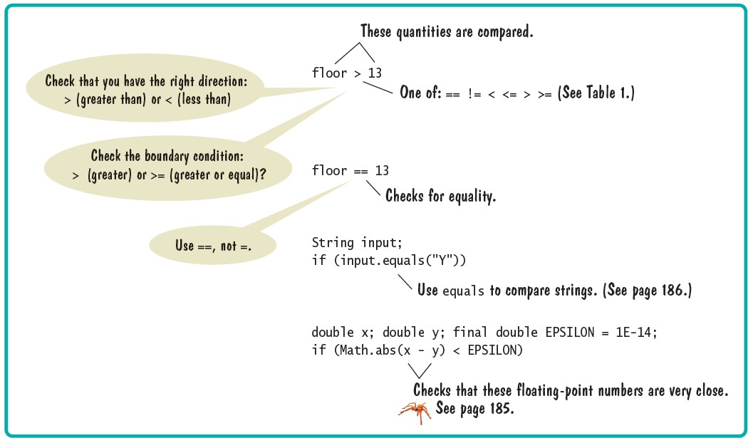
Syntax 5.2 Comparisons

Slide 19
Comparing Floating-Point Numbers
Consider this code:
double r = Math.sqrt(2); double d = r * r -2;
if (d == 0)
{
System.out.println("sqrt(2)squared minus 2 is 0");
}
else
{
System.out.println("sqrt(2)squared minus 2 is not 0 but " + d);
}
It prints:
sqrt(2)squared minus 2 is not 0 but 4.440892098500626E-16
This is due to round-off errors
When comparing floating-point numbers, don’t test for equality.
Check whether they are close enough.

Slide 20
Comparing Floating-Point Numbers
To avoid roundoff errors, don't use == to compare floating-point numbers.
To compare floating-point numbers test whether they are close enough:
|x - y| ≤ ε
final double EPSILON = 1E-14; if (Math.abs(x - y) <= EPSILON)
{
// x is approximately equal to y
}
ε is commonly set to 10⁻¹⁴

Slide 21
Comparing Strings
To test whether two strings are equal to each other, use equals
method:
if (string1.equals(string2)) . . .
Don't use == for strings!
if (string1 == string2) // Not useful
== tests if two strings are stored in the same memory location
equals method tests equal contents

Slide 22
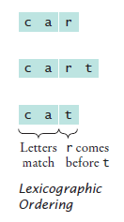
Comparing Strings - compareTo method
compareTo method compares strings in lexicographic order - dictionary order.
string1.compareTo(string2) < 0 means:
string1 comes before string2 in the dictionary
string1.compareTo(string2) > 0 means:
string1 comes after string2 in the dictionary
string1.compareTo(string2) == 0 means:
string1 and string2 are equal
Lexicographic Ordering

Slide 23

Lexicographic Ordering
Differences in dictionary ordering and ordering in Java
All uppercase letters come before the lowercase letters. "Z" comes before "a" The space character comes before all printable characters
Numbers come before letters Ordering of punctuation marks varies
To see which of two terms comes first in the dictionary, consider the first letter in which they differ

Slide 24
Comparing Objects
The == operator tests whether two object references are identical,
whether they refer to the same object.
Look at this code
Rectangle box1 = new Rectangle(5, 10, 20, 30); Rectangle box2 = box1;
Rectangle box3 = new Rectangle(5, 10, 20, 30);
box1 == box2 is true
box1 == box3 is false
Use the equals method to test if two rectangles have the same content
box1.equals(box3)
They have the same upper-left corner and the same width and height
Caveat: equals must be defined for the class

Slide 25
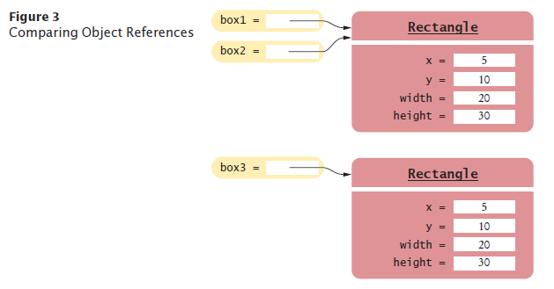
Object Comparison

Slide 26
Testing for null
null reference refers to no object:
String middleInitial = null; // Not set if ( . . . )
{
middleInitial = middleName.substring(0, 1);
}
Can be used in tests:
if (middleInitial == null)
{
System.out.println(firstName + " " + lastName);
}
else
{
System.out.println(firstName + " " + middleInitial + ". " + lastName);
}
Use ==, not equals, to test for null
null is not the same as the empty string ""

Slide 27
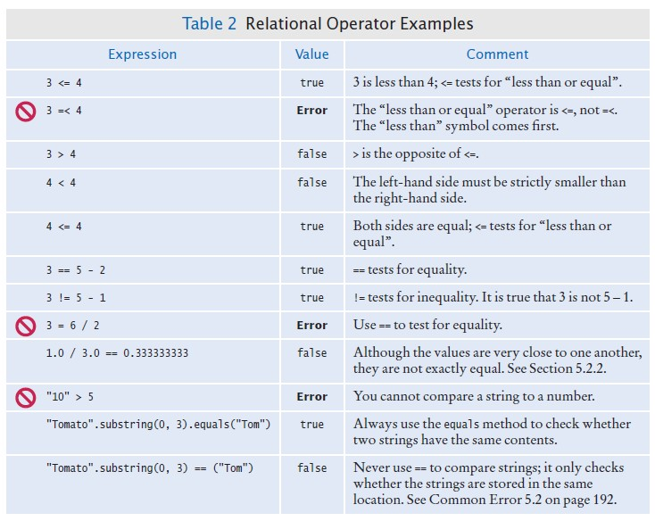
Relational Operator Examples

Slide 28
Self Check 5.6
Which of the following conditions are true, provided a is 3 and b is 4?
a + 1 <= b
a + 1 >= b
a + 1 != b
Answer: (a) and (b) are both true, (c) is false.

Slide 29
Self Check 5.7
Give the opposite of the condition floor > 13
Answer: floor <= 13

Slide 30
Self Check 5.8
What is the error in this statement?
if (scoreA = scoreB)
{
System.out.println("Tie");
}
Answer: The values should be compared with ==, not =.

Slide 31
Self Check 5.9
Supply a condition in this if statement to test whether the user entered a Y:
System.out.println("Enter Y to quit."); String input = in.next();
if (. . .)
{
System.out.println("Goodbye.");
}
Answer: input.equals("Y")

Slide 32
Self Check 5.10
Give two ways of testing that a string str is the empty string.
Answer: str.equals("") or str.length() == 0

Slide 33
Self Check 5.11
What is the value of s.length() if s is
the empty string ""?
the string " " containing a space?
null?
Answer: (a) 0; (b) 1; (c) an exception occurs.

Slide 34
Self Check 5.12
Which of the following comparisons are syntactically incorrect? Which of them are syntactically correct, but logically questionable?
String a = "1"; String b = "one"; double x = 1;
double y = 3 * (1.0 / 3);
a. a == "1"
a == null
a.equals("")
a == b
a == x
x == y
x - y == null
x.equals(y)
Answer: Syntactically incorrect: e, g, h. Logically questionable: a, d, f.

Slide 35
Multiple Alternatives: Sequences of Comparisons
Multiple if statements can be combined to evaluate complex decisions. You use multiple if statements to implement multiple alternatives.
Example: damage done by earthquake of a given magnitude on the Richter scale:
if (richter >= 8.0)
{
description = "Most structures fall";
}
else if (richter >= 7.0)
{
description = "Many buildings destroyed";
}
else if (richter >= 6.0)
{
description = "Many buildings considerably damaged, some collapse";
}
else if (richter >= 4.5)
{
description = "Damage to poorly constructed buildings";
}
else
{
description = "No destruction of buildings";
}

Slide 36
Multiple Alternatives: Sequences of Comparisons (Continue)
As soon as one of the four tests succeeds:
The effect is displayed
No further tests are attempted.
If none of the four cases applies
The final else clause applies
A default message is printed.

Slide 37
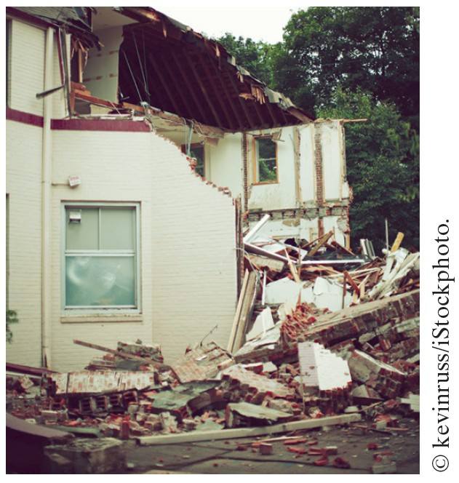
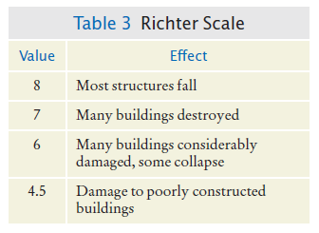
Multiple Alternatives
The 1989 Loma Prieta earthquake that damaged the Bay Bridge in San Francisco and destroyed many buildings measured 7.1 on the Richter scale.

Slide 38
Multiple Alternatives - Flowchart

Slide 39
Multiple Alternatives
The order of the if and else
Error
if matters
if (richter >= 4.5) // Tests in wrong order
{
description = "Damage to poorly constructed buildings";
}
else if (richter >= 6.0)
{
description = "Many buildings considerably damaged, some collapse";
}
else if (richter >= 7.0)
{
description = "Many buildings destroyed";
}
else if (richter >= 8.0)
{
description = "Most structures fall";
}
When using multiple if statements, test general conditions after more specific conditions.

Slide 40
Multiple Alternatives
In this example, must use if/else multiple independent if statements Error
if/else sequence, not just
if (richter >= 8.0) // Didn't use else
{
description = "Most structures fall";
}
if (richter >= 7.0)
{
description = "Many buildings destroyed";
}
if (richter >= 6.0)
{
description = "Many buildings considerably damaged, some collapse";
}
if (richter >= 4.5)
{
"Damage to poorly constructed buildings";
}
The alternatives are no longer exclusive.

Slide 41
Self Check 5.13
In a game program, the scores of players A and B are stored in variables scoreA and scoreB. Assuming that the player with the larger score wins, write an if/ else if/else sequence that prints out "A won", "B won", or "Game tied".
Answer:
if (scoreA > scoreB)
{
System.out.println("A won");
}
else if (scoreA < scoreB)
{
System.out.println("B won");
}
else
{
System.out.println("Game tied");
}

Slide 42
Self Check 5.14
Write a conditional statement with three branches that sets s to 1 if x is positive, to –1 if x is negative, and to 0 if x is zero.
Answer:
if (x > 0) { s = 1; }
else if (x < 0) { s = -1; } else { s = 0; }

Slide 43
Self Check 5.15
How could you achieve the task of Self Check 14 with only two branches?
Answer: You could first set s to one of the three values:
s = 0;
if (x > 0) { s = 1; }
else if (x < 0) { s = -1; }

Slide 44
Self Check 5.16
Beginners sometimes write statements such as the following:
if (price > 100)
{
discountedPrice = price - 20;
}
else if (price <= 100)
{
discountedPrice = price - 10;
}
Explain how this code can be improved.
Answer: The if (price <= 100) can be omitted (leaving just else), making it clear that the else branch is the sole alternative.

Slide 45
Self Check 5.17
Suppose the user enters -1 into the earthquake program. What is printed?
Answer: No destruction of buildings.

Slide 46
Self Check 5.18
Suppose we want to have the earthquake program check whether the user entered a negative number. What branch would you add to the if statement, and where?
Answer: Add a branch before the final else:
else if (richter < 0)
{
System.out.println("Error: Negative input");
}

Slide 47
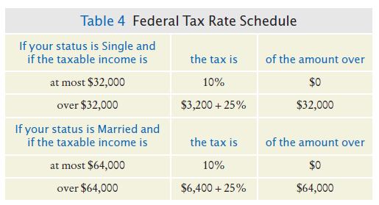

Nested Branches
Nested set of statements:
An if statement inside another
Example: Federal Income Tax
Tax depends on marital status and income
We say that the income test is nested inside the test for filing status
Two-level decision process is reflected in two levels of if statements in the program
Computing income taxes requires multiple levels of decisions.

Slide 48
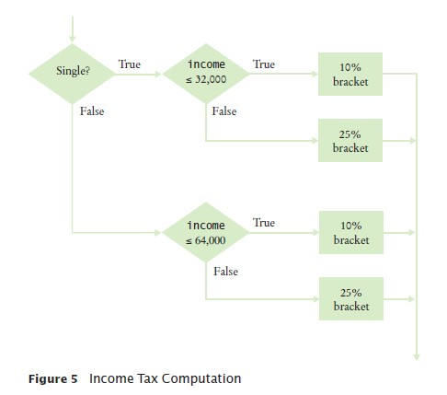
Nested Branches - Flowchart

Slide 49
section_4/TaxReturn.java
1 /**
2 A tax return of a taxpayer in 2008.
3 */
4 public class TaxReturn
5 {
public static final int SINGLE = 1;
public static final int MARRIED = 2;
8
9
10
11
12
13
14
15
16
17
18
19
20
21
22
23
24
25
26
27
28
29
30
31
32
33
34
35
private static final double RATE1 = 0.10; private static final double RATE2 = 0.25;
private static final double RATE1_SINGLE_LIMIT = 32000; private static final double RATE1_MARRIED_LIMIT = 64000;
private double income; private int status;
/**
Constructs a TaxReturn object for a given income and marital status.
@param anIncome the taxpayer income
@param aStatus either SINGLE or MARRIED
*/
public TaxReturn(double anIncome, int aStatus)
{
income = anIncome; status = aStatus;
}
public double getTax()
{
double tax1 = 0; double tax2 = 0;
if (status == SINGLE)
{

Slide 50
section_4/TaxCalculator.java
1 import java.util.Scanner;
2
3 /**
4 This program calculates a simple tax return.
5 */
6 public class TaxCalculator
7 {
8 public static void main(String[] args)
9 {
10 Scanner in = new Scanner(System.in);
11
12
13
14
15
16
17
18
19
20
21
22
23
24
25
26
27
28
29
30 }
System.out.print("Please enter your income: "); double income = in.nextDouble();
System.out.print("Are you married? (Y/N) "); String input = in.next();
int status;
if (input.equals("Y"))
{
status = TaxReturn.MARRIED;
}
else
{
status = TaxReturn.SINGLE;
}
TaxReturn aTaxReturn = new TaxReturn(income, status); System.out.println("Tax: "
+ aTaxReturn.getTax());
}
Program Run:
Please enter your income: 80000
Are you married? (Y/N) Y
Tax: 10400.0

Slide 51
Self Check 5.19
What is the amount of tax that a single taxpayer pays on an income of $32,000?
Answer: 3200.

Slide 52
Self Check 5.20
Would that amount change if the first nested if statement changed from
if (income <= RATE1_SINGLE_LIMIT)
to
if (income < RATE1_SINGLE_LIMIT)
Answer: No. Then the computation is 0.10 × 32000 + 0.25 × (32000 – 32000).

Slide 53
Self Check 5.21
Suppose Harry and Sally each make $40,000 per year. Would they save taxes if they married?
Answer: No. Their individual tax is $5,200 each, and if they married, they would pay $10,400. Actually, taxpayers in higher tax brackets (which our program does not model) may pay higher taxes when they marry, a phenomenon known as the marriage penalty.

Slide 54
Self Check 5.22
How would you modify the TaxCalculator.java program in order to check that the user entered a correct value for the marital status (i.e., Y or N)?
Answer: Change else in line 22 to
else if (maritalStatus.equals("N"))
and add another branch after line 25:
else
{
System.out.println(
"Error: Please answer Y or N.");
}

Slide 55
Self Check 5.23
Some people object to higher tax rates for higher incomes, claiming that you might end up with less money after taxes when you get a raise for working hard. What is the flaw in this argument?
Answer: The higher tax rate is only applied on the income in the higher bracket. Suppose you are single and make $31,900. Should you try to get a $200 raise? Absolutely: you get to keep 90 percent of the first $100 and 75 percent of the next $100.

Slide 56
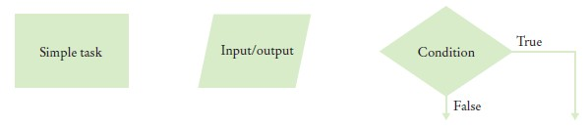
Problem Solving: Flowcharts
A flowchart shows the structure of decisions and tasks that are required to solve a problem.
Flowcharts are made up of elements for tasks, input/output, and decisions.
Figure 6 Flowchart Elements
Link tasks and input/output boxes in the sequence in which they should be executed.

Slide 57
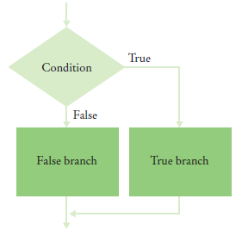
Problem Solving: Flowcharts
Whenever you need to make a decision, draw a diamond with two outcomes
Figure 7 Flowchart with Two Outcomes With multiple choices

Slide 58
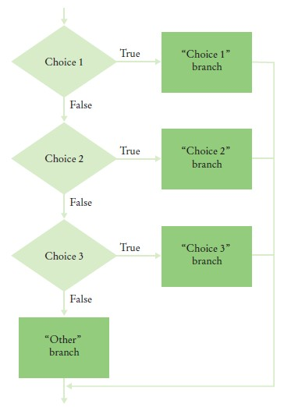
Figure 8 Flowchart with Multiple Choices

Slide 59
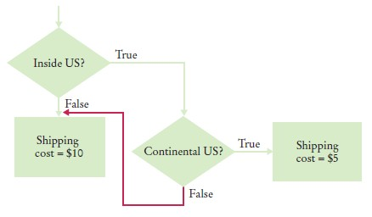
Problem Solving: Flowcharts
Each branch of a decision can contain tasks and further decisions. Never point an arrow inside another branch.
BAD - spaghetti code

Slide 60
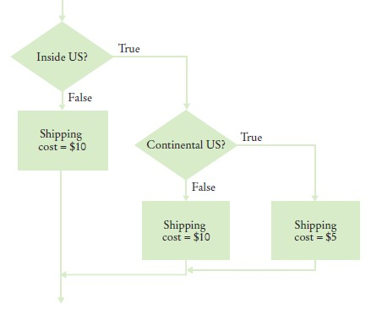
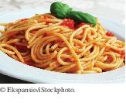
Problem Solving: Flowcharts
GOOD - better design
In the future the cost for international shipments may be different from that to Alaska and Hawaii.
Spaghetti code has so many pathways that it becomes impossible to understand.

Slide 61
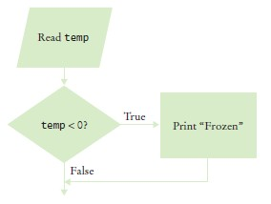
Self Check 5.24
Draw a flowchart for a program that reads a value temp and prints “Frozen” if it is less than zero.
Answer:

Slide 62
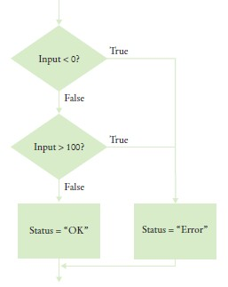
Self Check 5.25
What is wrong with this flowchart?
Answer: The “True” arrow from the first decision points into the “True” branch of the second decision, creating spaghetti code.

Slide 63
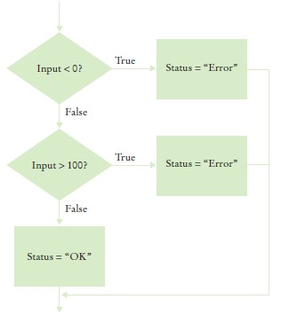
Self Check 5.26
How do you fix the flowchart of Self Check 25?
Answer: Here is one solution. In Section 5.7, you will see how you can combine the conditions for a more elegant solution.

Slide 64
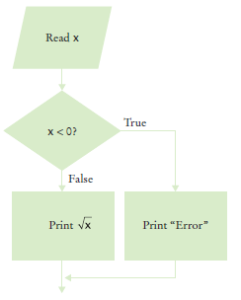
Self Check 5.27
Draw a flowchart for a program that reads a value x. If it is less than zero, print “Error”. Otherwise, print its square root.
Answer:

Slide 65
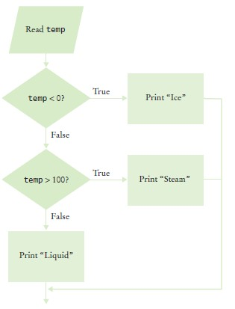
Self Check 5.28
Draw a flowchart for a program that reads a value temp. If it is less than zero, print “Ice”. If it is greater than 100, print “Steam”. Otherwise, print “Liquid”.
Answer:

Slide 66
Problem Solving: Selecting Test Cases
Black-box testing: a testing method that does not take the structure of the implementation into account.
White-box testing uses information about the structure of a program.
Perform unit tests of each method
Code coverage is a measure of how many parts of a program have been tested.
Look at every if/else branch to see that each of them is reached by some test case
Boundary test cases are test cases that are at the boundary of acceptable inputs.
It is a good idea to design test cases before implementing a program.

Slide 67
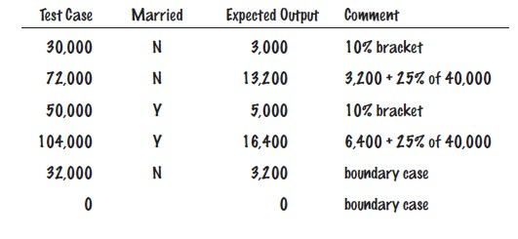
Problem Solving: Selecting Test Cases
A plan for the TaxReturn class
There are two possibilities for the marital status and two tax brackets for each status, yielding four test cases
Test a handful of boundary conditions, such as an income that is at the boundary between two brackets, and a zero income.
Test an invalid input, such as a negative income
Test cases and expected outcomes

Slide 68
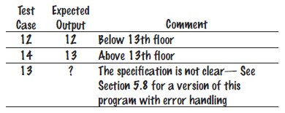
Self Check 5.29
Using Figure 1 on page 179 as a guide, follow the process described in this section to design a set of test cases for the ElevatorSimulation.java program in Section 5.1.
Answer:

Slide 69
Self Check 5.30
What is a boundary test case for the algorithm in How To 5.1 on page 190? What is the expected output?
Answer: A boundary test case is a price of $128. A 16 percent discount should apply because the problem statement states that the larger discount applies if the price is at least $128. Thus, the expected output is
$107.52.

Slide 70
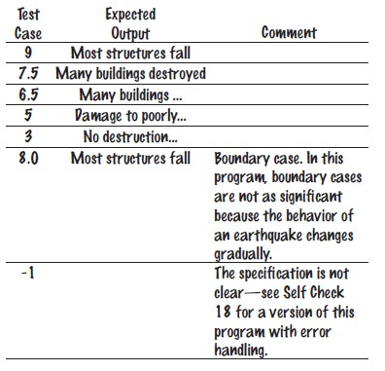
Self Check 5.31
Using Figure 4 on page 194 as a guide, follow the process described in Section 5.6 to design a set of test cases for the Earthquake.java program in Section 5.3.
Answer:

Slide 71
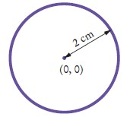
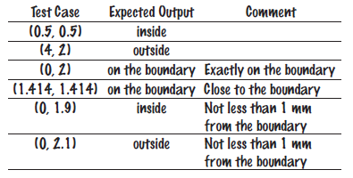
Self Check 5.32
Suppose you are designing a part of a program for a medical robot that has a sensor returning an x- and y-location (measured in cm). You need to check whether the sensor location is inside the circle, outside the circle, or on the boundary (specifically, having a distance of less than 1 mm from the boundary). Assume the circle has center (0, 0) and a radius of 2 cm. Give a set of test cases.
Answer:

Slide 72

Boolean Variables and Operators
To store the evaluation of a logical condition that can be true or false, you use a Boolean variable.
The boolean data type has exactly two values, denoted false and
true.
boolean failed = true;
Later in your program, use the value to make a decision
if (failed) // Only executed if failed has been set to true
{
. . .
}
A Boolean variable is also called a flag because it can be either up (true) or down (false).

Slide 73
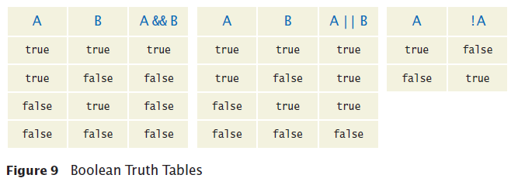
Boolean Variables and Operators
You often need to combine Boolean values when making complex decisions
An operator that combines Boolean conditions is called a Boolean operator.
The && operator is called and
Yields true only when both conditions are true.
The || operator is called or
Yields the result true if at least one of the conditions is true.

Slide 74
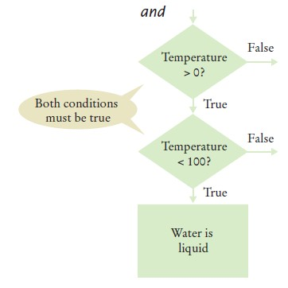
Boolean Variables and Operators
To test if water is liquid at a given temperature
if (temp > 0 && temp < 100) { System.out.println("Liquid"); }
Flowchart

Slide 75
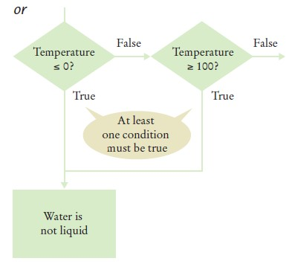
Boolean Variables and Operators
To test whether water is not liquid at a given temperature
if (temp <= 0 || temp >= 100) { System.out.println("Not liquid"); }
Flowchart

Slide 76
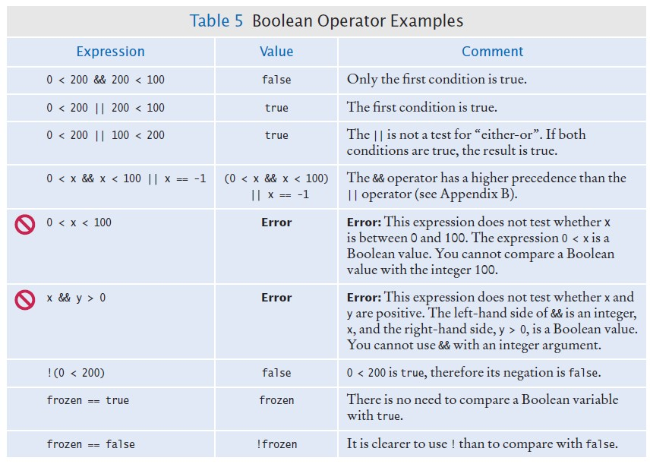
Boolean Variables and Operators

Slide 77
Boolean Variables and Operators
To invert a condition use the not Boolean operator The ! operator takes a single condition
Evaluates to true if that condition is false and Evaluates to false if the condition is true
To test if the Boolean variable frozen is false:
if (!frozen) { System.out.println("Not frozen"); }

Slide 78
Self Check 5.33
Suppose x and y are two integers. How do you test whether both of them are zero?
Answer: x == 0 && y == 0

Slide 79
Self Check 5.34
How do you test whether at least one of them is zero?
Answer: x == 0 || y == 0

Slide 80
Self Check 5.35
How do you test whether exactly one of them is zero?
Answer: (x == 0 && y != 0) || (y == 0 && x != 0)

Slide 81
Self Check 5.36
What is the value of !!frozen?
Answer: The same as the value of frozen.

Slide 82
Self Check 5.37
What is the advantage of using the type boolean rather than strings "false"/"true" or integers 0/1?
Answer: You are guaranteed that there are no other values. With strings or integers, you would need to check that no values such as "maybe" or
–1 enter your calculations.

Slide 83
Application: Input Validation
You need to make sure that the user-supplied values are valid before you use them.
Elevator example: elevator panel has buttons labeled 1 through 20 (but not 13)
The number 13 is invalid
if (floor == 13)
{
System.out.println("Error: There is no thirteenth floor.");
}
Numbers out of the range 1 through 20 are invalid
if (floor <= 0 || floor > 20)
{
System.out.println("Error: The floor must be between 1 and 20.");
}
To avoid input that is not an integer
if (in.hasNextInt())
{
int floor = in.nextInt();
// Process the input value.
}
else
{
System.out.println("Error: Not an integer.");
}

Slide 84
Section_8/ElevatorSimulation2.java
1 import java.util.Scanner;
2
3 /**
This program simulates an elevator panel that skips the 13th floor, checking for
input errors.
6 */
7 public class ElevatorSimulation2
8 {
9 public static void main(String[] args)
10 {
Scanner in = new Scanner(System.in);
System.out.print("Floor: ");
if (in.hasNextInt())
14 {
15 // Now we know that the user entered an integer
16
17 int floor = in.nextInt();
18
19
20
21
22
23
24
25
26
27
28
29
30
31
32
33
34
35
if (floor == 13)
{
System.out.println("Error: There is no thirteenth floor.");
}
else if (floor <= 0 || floor > 20)
{
System.out.println("Error: The floor must be between 1 and 20.");
}
else
{
// Now we know that the input is valid
int actualFloor = floor; if (floor > 13)
{
actualFloor = floor - 1;
}
Program Run:
Floor: 13
Error: There is no thirteenth floor.

Slide 85
Self Check 5.38
In the ElevatorSimulation2 program, what is the output when the input is a. 100?
b. –1?
c. 20?
d. thirteen?
Answer:
(a) Error: | The | floor must be between 1 and 20.
(b) Error: | The | floor must be between 1 and 20.
(c) 19
(d) Error: | Not | an integer.

Slide 86
Self Check 5.39
Your task is to rewrite lines 19–26 of the ElevatorSimulation2 program so that there is a single if statement with a complex condition. What is the condition?
if (. . .)
{
System.out.println("Error: Invalid floor number");
}
Answer: floor == 13 || floor <= 0 || floor > 20

Slide 87
Self Check 5.40
In the Sherlock Holmes story “The Adventure of the Sussex Vampire”, the inimitable detective uttered these words: “Matilda Briggs was not the name of a young woman, Watson, … It was a ship which is associated with the giant rat of Sumatra, a story for which the world is not yet prepared.” Over a hundred years later, researchers found giant rats in Western New Guinea, another part of Indonesia. Suppose you are charged with writing a program that processes rat weights. It contains the statements
System.out.print("Enter weight in kg: "); double weight = in.nextDouble();

Slide 88
What input checks should you supply?
Answer: Check for in.hasNextDouble(), to make sure a researcher didn't supply an input such as oh my. Check for weight <= 0, because any rat must surely have a positive weight. We don’t know how giant a rat could be, but the New Guinea rats weighed no more than 2 kg. A regular house rat (rattus rattus) weighs up to 0.2 kg, so we’ll say that any weight > 10 kg was surely an input error, perhaps confusing grams and kilograms. Thus, the checks are
if (in.hasNextDouble())
{
double weight = in.nextDouble(); if (weight < 0)
{
System.out.println("Error: Weight cannot be negative.");
}
else if (weight > 10)
{
System.out.println("Error: Weight > 10 kg.");
}
else
{
Process valid weight.
}
}
else
}
System.out.print("Error: Not a number");
}

Slide 89
Self Check 5.41
Run the following test program and supply inputs 2 and three at the prompts. What happens? Why?
import java.util.Scanner public class Test
{
public static void main(String[] args)
{
Scanner in = new Scanner(System.in); System.out.print("Enter an integer: "); int m = in.nextInt();
System.out.print("Enter another integer: "); int n = in.nextInt();
System.out.println(m + " " + n);
}
}
Answer: The second input fails, and the program terminates without printing anything.

